Slide 1

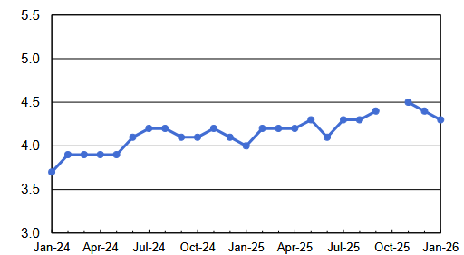
The Fed's "minutes"
Liquidity
Solutions
n°182 l 19 February 2026
Divergence within the Fed
Figure of the week
Federal Reserve officials agreed almost unanimously last month to leave interest rates unchanged, according to the minutes published on Wednesday. Still, two participants said they favored a rate cut Governors Christopher Waller and Stephen Miran who expressed concerns about a potential slowdown in the labor market.
The divergences were wider among the seventeen participants, when they openly raised for the first time the hypothesis of a rate hike if inflation were to remain above the 2% target.
However, some governors believe that rates should be left unchanged "for a while" in order to have new economic data and new inflation figures. The fear is that a cut may not be appropriate until there is evidence of "disinflation on track".
However, inflation seems to be on the path to slow this year, which should pave the way for further easing of the Fed's monetary policy. The market is anticipating a rate cut in July followed by another in the 4th quarter.
206K
Weekly US jobless claims (Feb.26)
Unemployment down
Evolution of US unemployment (%)
But this report contains other more worrying figures: the data for previous years have been revised downwards sharply. Since Donald Trump's return to power, only 180,000 jobs have been created, or 15,000 per month, the slowest pace since the recession years linked to the 2008 financial crisis or the Covid-19 pandemic.
In other words, American growth, which is showing a remarkable pace, is maintaining itself with little or no new jobs. Donald Trump especially remembered the first part of the report, welcoming "exceptional employment figures, much more than expected!"
Source: Amundi, Bureau of Labor Statistics

Slide 2
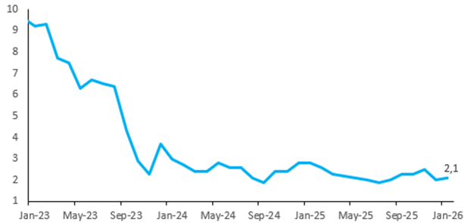
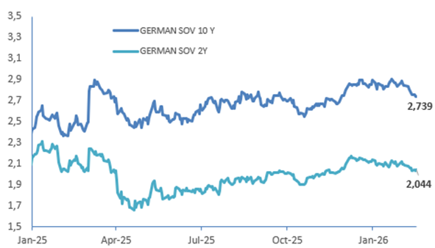
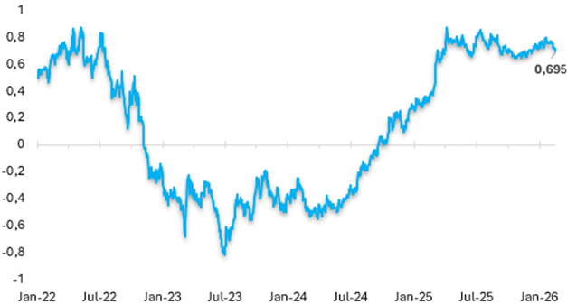
Germany: Inflation accelerates
Germany's annual inflation rate rose to 2.1% in January 2026, from 1.8% in December, confirming estimates.
This level slightly exceeds the ECB's 2% target. The increase was mainly driven by consumer goods, whose prices rose by 1.3% against 0.8% the previous month, with a marked increase in food (+1.0%).
Durable goods rebounded (0.4% after −0.3%), also contributing to the general rise in prices. Services inflation slowed to 3.2% in January (from 3.5% in December), but remains at a high level.
.
German inflation rate (%)
“
Source: Amundi, Bloomberg
”
We clearly indicated that headline inflation would fall below 2% in early 2026, and that has been the trajectory so far
Luis de Guindos, ECB Vice-President, 10/02/2026
Market impact
German sovereign rates (%)
German 2-year and 10-year rates continue to fall in a context of "flight to quality".
Source: Amundi, Bloomberg
Germany – France Spread (bp)
Tightening of the Germany-France spread
Source: Amundi, Bloomberg

Slide 3
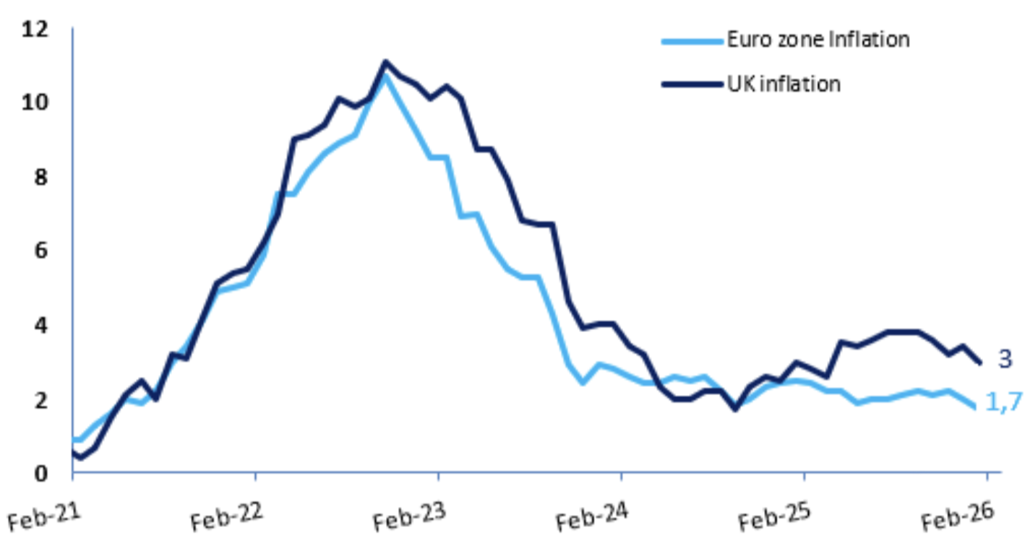







United Kingdom: inflation down
British inflation has fallen to its lowest level since March 2025, according to official data. These reinforce expectations of an upcoming interest rate cut by the Bank of England.
Consumer prices rose 3% year-on-year in January, slowing sharply after a 3.4% rise in December, the Office for National Statistics said on Wednesday, while transport and food prices rose more slowly.
Food inflation – seen by the Bank of England as a key element influencing public expectations about prices more broadly – recorded its lowest level since April last year. Airfares fell sharply over the month after surging in December.
Core inflation, which excludes energy, food, alcoholic beverages and tobacco, rose 3.1% in January, its lowest level since 2021.
Markets are now pricing in nearly 90% of the Bank of England's rate cut in March – up from around 80% before the data was released – followed by another cut by the end of 2026.
UK vs Eurozone inflation (%)
Source: Bloomberg, Amundi
News
Agenda
Germany | Final inflation rate at
2.1% (Jan)
20 February l Publication of PMIs
in the euro area (Feb)
Eurozone | Zew Sentiment Index
Economic at 39.4 (Feb)
27 February l Publication of the inflation rate
In France (Feb)
Authors
Disclaimer
This publication is intended for institutional clients only and may not be reproduced, in whole or in part, or communicated to third parties without our permission. Published by Amundi Asset Management, Société par Actions Simplifiée SAS, with a capital of €1,143,615,555 - 437 574 452 RCS Paris. Asset Management Company approved by the AMF Autorité des Marchés Financiers) n°GP 04000036. Registered office: 91 93, boulevard Pasteur 75015 Paris France. The information contained in this publication is not intended for dissemination to, or use by, any person or entity in any country or jurisdiction where such dissemination would be contrary to law or regulation, or which would subject Amundi or its affiliates to registration obligations in such countries. Not all products or services are necessarily registered or authorized in all countries or available to all customers. The data and information contained in this publication are provided for informational purposes only. Nothing contained in this publication constitutes an offer or solicitation by any member of the Amundi group to provide investment advice or services or to buy or sell any financial instruments. The information contained in this publication is based on sources that we believe to be reliable, but we do not warrant that it is accurate, complete, valid or up-to-date and should not be relied upon as such for any purpose.
Follow us

